Slide 1
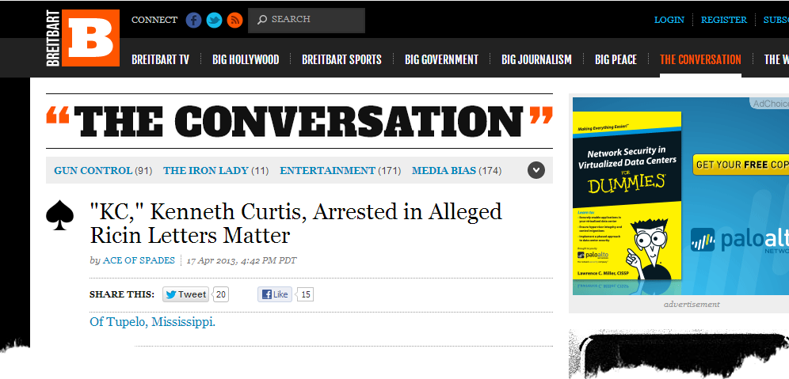
Wow, am I glad to be here!

Slide 2
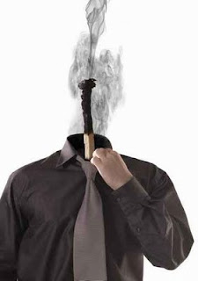

It’s Better to Burnout (than to fade away)?
Burnout in the Information Security Industry

Slide 3

This slide is dedicated to anyone in attendance that has entered this presentation and
already has decided that we are full of crap.

Slide 4

Let Me Get This Out of the Way

Slide 5

Who Are We?

Slide 6

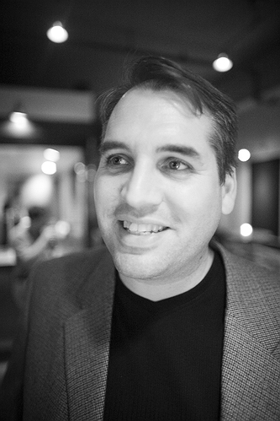
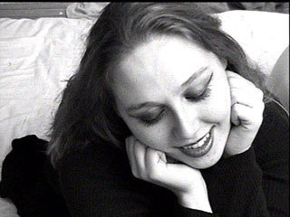
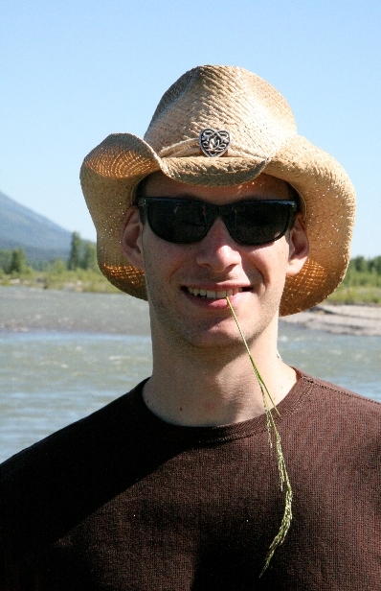



Security Burnout Working Panel
Jack Daniel
@jack_daniel
Martin McKeay
@mckeay
Stacy Thayer
@stacythayer
Gal Shpantzer
@shpantzer
Josh Corman
@joshcorman
K.C. Yerrid
@K0nsp1racy
@secburnout or @itburnoutdotorg

Slide 7

What do we mean by burnout?

Slide 8
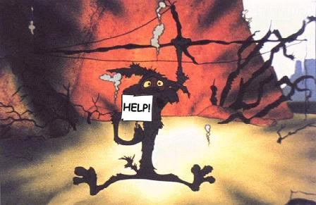
What do we mean by burnout?

Slide 9
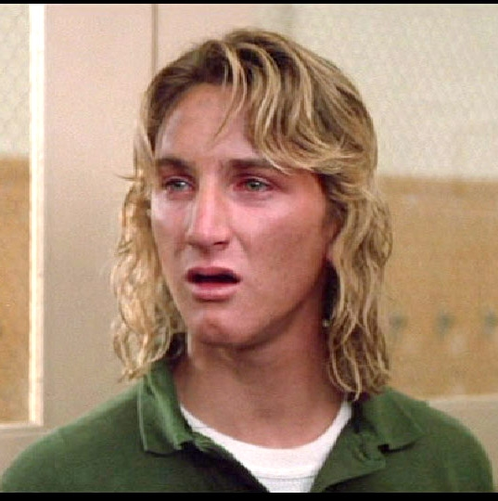
What do we mean by burnout?

Slide 10
What do we mean by burnout?

Slide 11

“I have it good, very good, and I'm grateful, but since the age of seven, I've become hateful towards all humans in general. Only because it seems so easy for people to get along and have empathy. Only because I love and feel sorry for people too much I guess. Thank you all from the pit of my burning, nauseous stomach for your letters and concern during the past years. I'm too much of an erratic, moody, baby! I don't have the passion anymore, and so remember, it's better to burn out then to fade away. Peace, Love, Empathy. Kurt Cobain.”

Slide 12
“I have it good, very good, and I'm grateful, but since the age of seven, I've become hateful towards all humans in general. Only because it seems so easy for people to get along and have empathy. Only because I love and feel sorry for people too much I guess. Thank you all from the pit of my burning, nauseous stomach for your letters and concern during the past years. I'm too much of an erratic, moody, baby! I don't have the passion anymore, and so remember, it's better to burn out then to fade away. Peace, Love, Empathy. Kurt Cobain.”

Slide 13
We’re Here to Help, But…
Moral support, yes.
Clinical support, no.
We are not therapists or counselors.
The psychologists on the team are not your psychologists.
We aren't even qualified bartenders.

Slide 14
Clinical Definition of Burnout
a popular term for a mental or physical energy depletion after a period of chronic, unrelieved job-related stress characterized sometimes by physical illness.
Source: Mosby's Medical Dictionary, 8th edition. © 2009, Elsevier.

Slide 15

Some folks say…
We are well paid
We have cushy jobs that do not require physical strength
We are not getting shot at, rescuing children from burning buildings, or even wearing underwear over our pantyhose.

Slide 16

Aren’t you just being a bunch of…

Slide 17
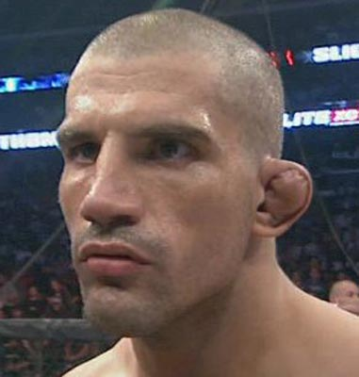
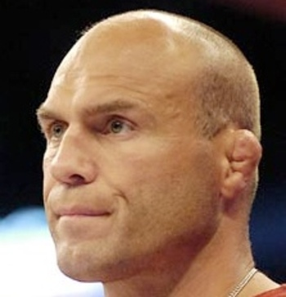
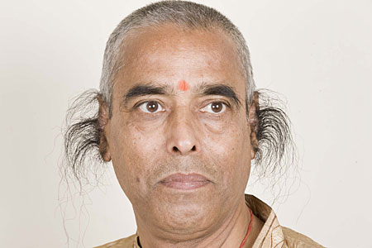
Hear us out…

Slide 18
Burnout is well-documented in other human service professions…
The reason why burnout is so prevalent in the human service professions is due in part to the
high stress environment
emotional involvedness
outcomes that might be independent of the effort exerted by the working individual.
Sound Familiar?
Source: van Dierendock, Garssen, Visser (2005).
Notes:
Draw parallels to characteristics of Info security and IT professionals…
Draw parallels to the “A” players on the team, not the “C” players… This is one reason why Management needs to pay attention.

Slide 19
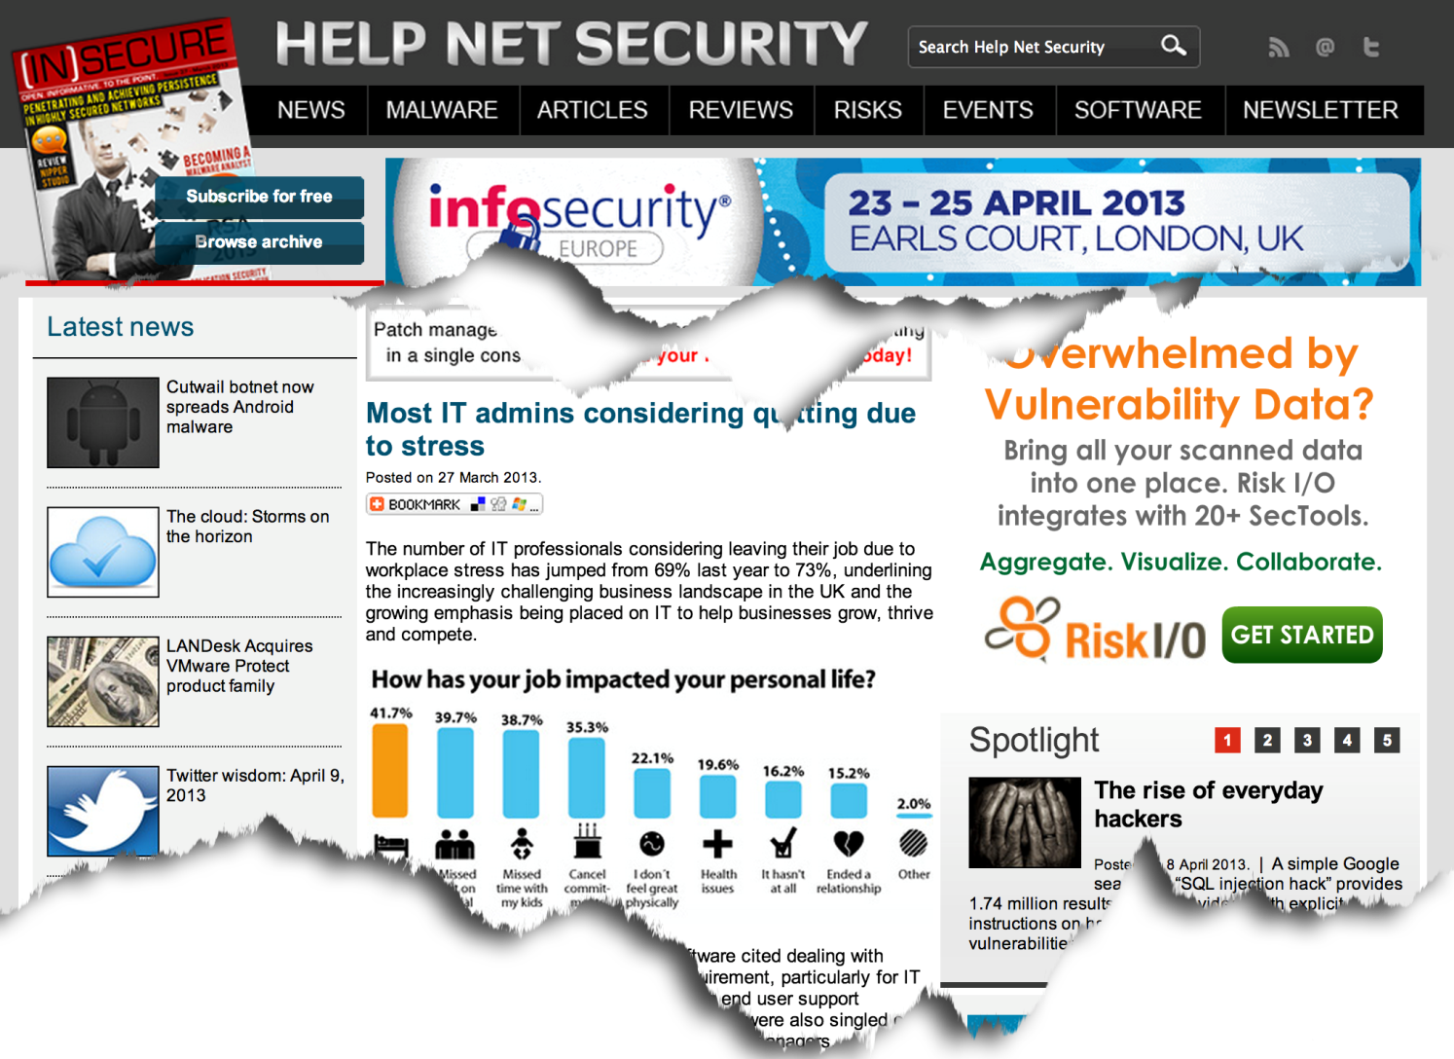
Notes:
Some of the numbers:
207 IT Administrators in the US.
67% in 2012 and 57% in 2013 considered leaving their job due to workplace stress. We’re getting better, right???? Uhhhh…
Nearly 33% of those surveyed work more than 8 hours of overtime to keep on top of their workload.
21% have suffered stress-related health issues, compared to 20% from 2012
206 IT Administrators in UK.
69% in 2012 and 73% in 2013 considered leaving their job due to workplace stress.
49% of respondents are working 6 or more hours of overtime per week to keep on top of their workload.
18% have suffered stress-related health issues, which is actually down from 2012 (29%)
Top three sources of stress? Management, tight deadlines, and lack of budget.
The point here is that this extends beyond the pure play information security practitioner and encompasses IT practitioners in general.

Slide 20
What Causes Occupational Burnout?

Slide 21
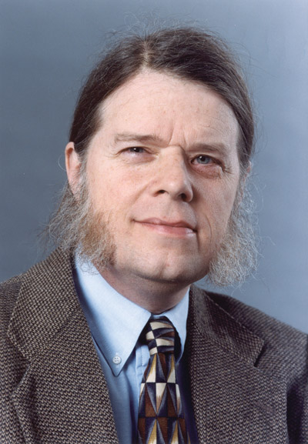
What Causes Burnout?
Dan Geer says (regarding information security), “Security is too wide to master, too deep to know, and too fast to photograph.”
The individuals who are most vulnerable to occupational burnout are ones who are strongly motivated, dedicated, and involved in the work in which they partake.

Slide 22
What Causes Burnout?
Maslach notes six major mismatches / sources between people and their jobs:
Work overload
Lack of control
Insufficient reward
Breakdown of community
Absence of fairness
Conflicting values

Slide 23

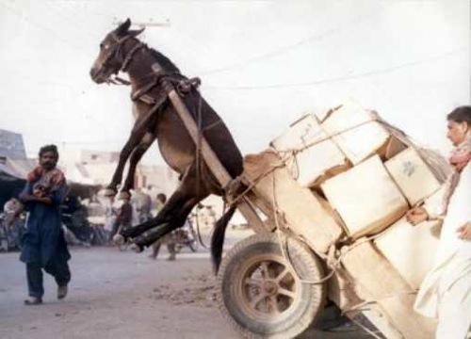
Work Overload
Notes:
From the organizational perspective, workload means productivity. From the individual’s perspective, workload means time and energy. It is this dissonance of perspectives that make finding a compromise a fundamental challenge in many organizations today. In the quest for increased productivity, the organization can push people beyond what they can sustain.
In addition, while organizations seek to become more productive through better design and automation, this goal is not realized as often as it is believed. Productivity is more often achieved because the employees work harder and longer, not because an intelligent system has increased productivity. Work becomes more complex and more intense. We are monitoring firewall logs and chasing down regulatory artifacts. We are patching systems and remaining accountable to uptime quotas. We are expected to respond to every port scan of our network yet maintain a portfolio of projects. Pressure increases. Personal time is sacrificed. The productivity gains are smoke and mirrors and temporary in nature. Something has to give.

Slide 24
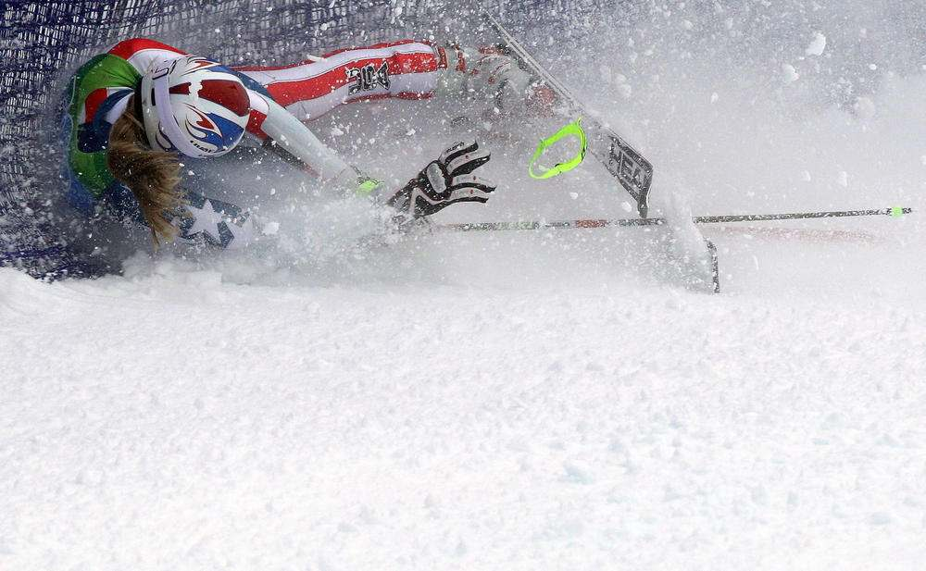
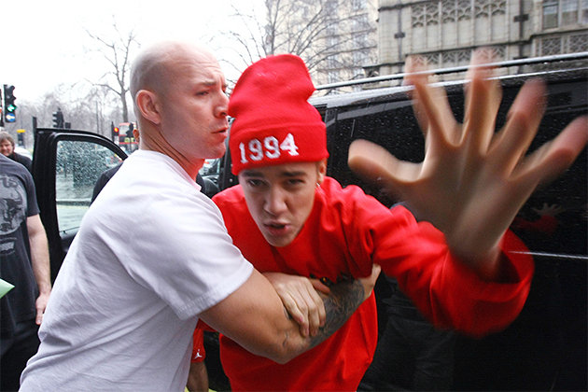

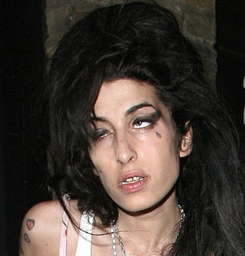
Lack of Control
Notes:
Information security professionals are geeks. Our capacity to set priorities for our own workload is fundamental to our well-being. However, many of us have a difficult time knowing what each day has in store for us. Part of this is the nature of our profession, but part of it is overlapped with work overload. When people do not feel they have control over important aspects of their work, it is not a question of empowerment over their ability to analytically solve problems; rather, whether the control structures and the organization will support their creative problem solving methods.
In organizations that are perceived to be filled by micromanaging tendencies, security professionals may perceive the practice as an inherent lack of trust as the micromanagement deny the professional the ability to exercise their professional judgment. Sometimes this is accurate; however, this is not always the case. Management may be under short term pressures, including financial cost controls or organizationally trying to change the central culture.

Slide 25
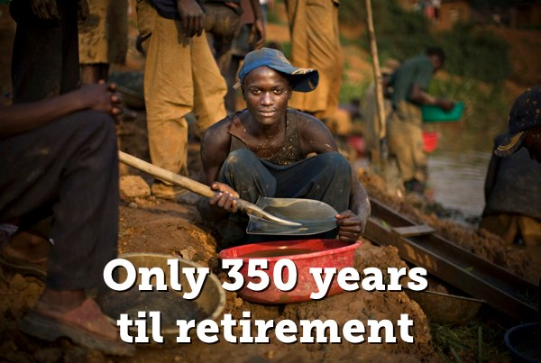
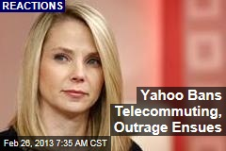
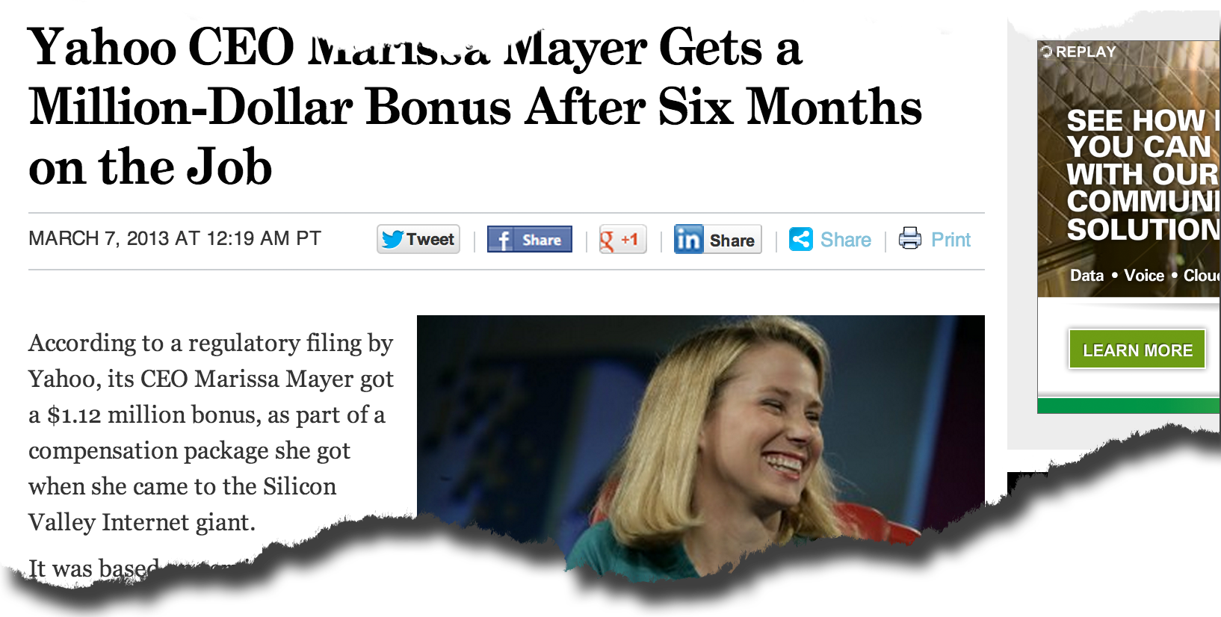
Insufficient Reward
Notes:
If you think of the organizational context since the dot com bubble, you may notice how most organizations are trying to do more with less. Insufficient reward is both material and intrinsic in nature. From the material perspective, money is tight unless it is directly producing revenue for the organization. Executives are asking people to take pay cuts to keep their jobs, forgoing bonus allocations, and otherwise redacting many of the benefits that their employees have become accustomed to. Employees have been taking their lumps in the short term with the expectation that over the long term they will be rewarded justly for their sacrifices. This is no longer happening. Companies are swinging the hatchet, promoting fewer people, and plateauing raises and merit increases. While materialistically, our rewards may be getting trimmed, more concerning is the intrinsic benefits that our jobs used to provide.
The most recent example that has received a ton of publicity is Yahoo’s CEO Marissa Mayer and her decision to end telecommuting arrangements. While the occassional telecommuting is still alledgedly acceptable, work from home arrangements will not be allowed. Time will tell how the long-term impact will affect the morale and the culture amongst their Yahoos (as the arrangement is due to be implemented in June), but with some areas of our country experiencing negative unemployment, this was a very risky decision given alternatives. If you are truly satisfied at your job, you are focused on the work, not the rewards.

Slide 26
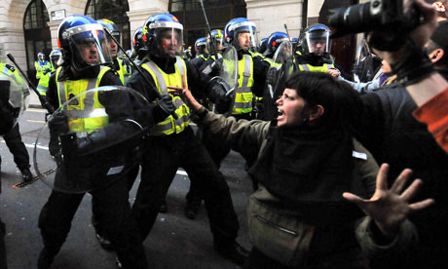
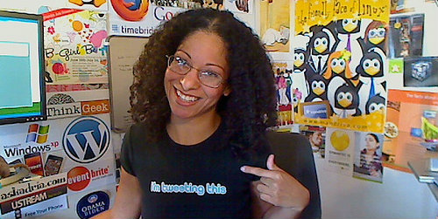
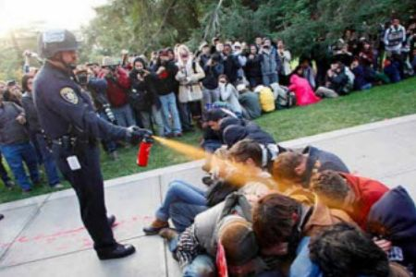
Breakdown of Community
Notes:
If we examine the effects of a rumored layoff, a number of things can be observed that erode the community within the organization. Trust amongst peers and colleagues is diminished both directly and indirectly. When this happens, a breakdown of community occurs. Consider the notion that

Slide 27

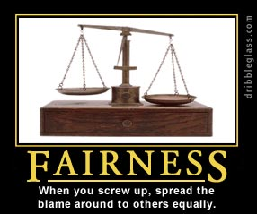
Absence of Fairness

Slide 28
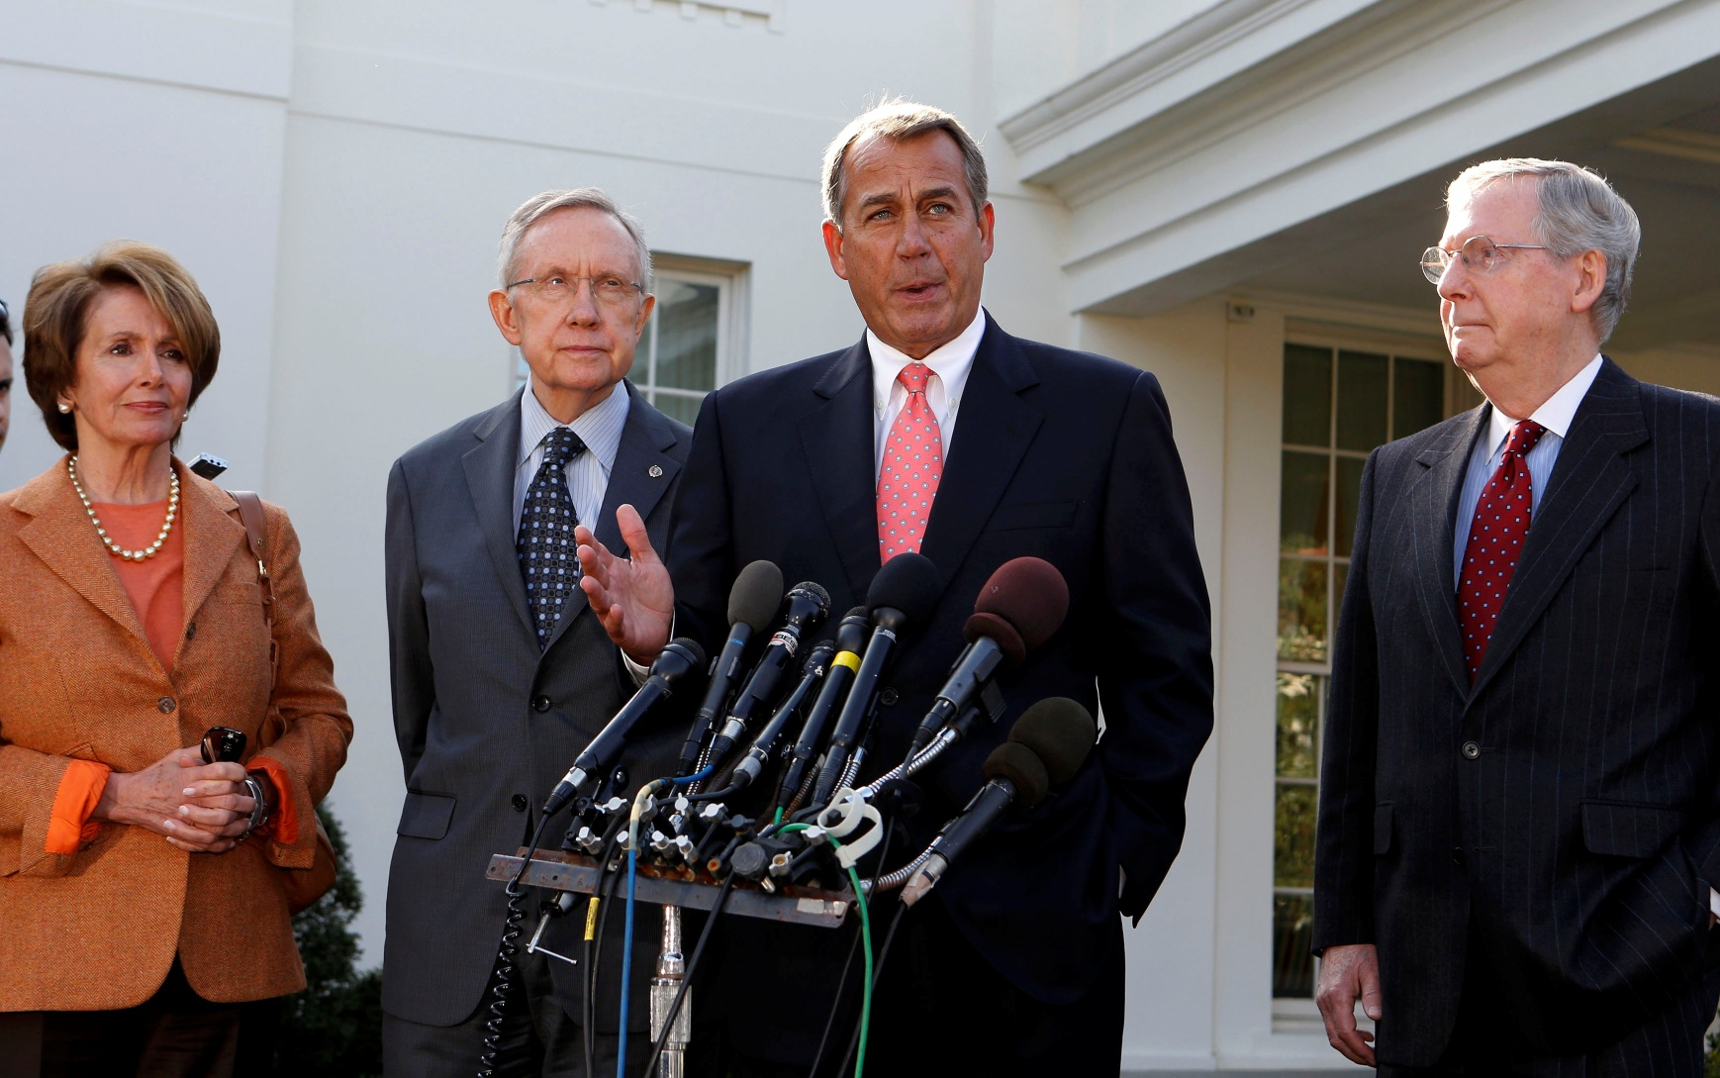
Conflicting Values

Slide 29
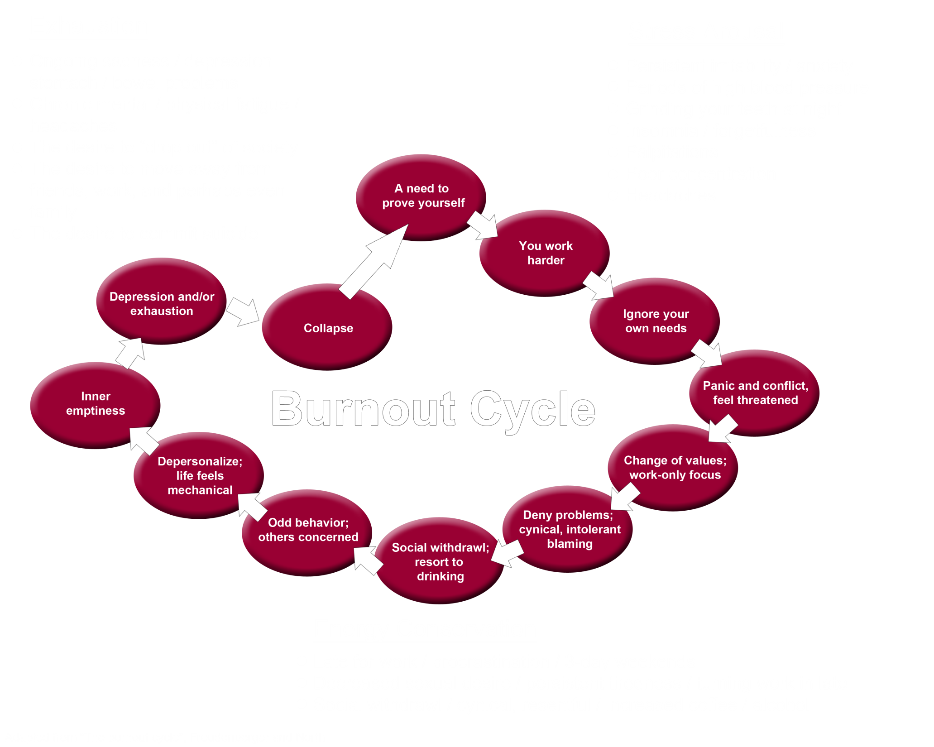

Slide 30
Research Findings Thus Far

Slide 31
Research on Occupational Burnout in Information Security
Two surveys to date:
1st: ≈ 400 responses
Awesome first attempt, but…
Not randomized
Potential validity issues
Mostly Twitter-generated responses
No duplicate prevention controls
Uncontrolled for selection and confirmation bias
2nd: 124 valid responses
Validated survey instrument
Still not perfect, particularly on selection and confirmation bias.

Slide 32
1st Survey By The Numbers
90% Male
91% under 45
87% middle management or individual contributor
74% at least moderately stressed
55% cite job satisfaction as major stressor (higher than finances and family)

Slide 33
Key Findings From 1st Survey

Slide 34
About the 2nd Survey
Based on Maslach’s Burnout Inventory
Most recognized instrument around the world
Measures Along 3 scales:
Exhaustion: extreme weakness or fatigue
Cynicism: bitter, distrustful, pessimistic
Efficacy: effectiveness or capacity to produce a desired result

Slide 35
2nd Survey By the Numbers
111 valid responses
12.9% scored in the “red zone” on all three scales and needed immediate help.
46.8% were not in any of the red zones.

Slide 36
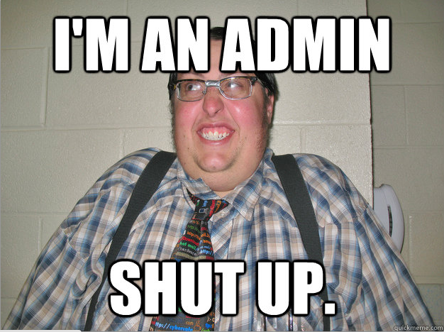
How did we stack up?
We are on the good side of efficacy.
We are on the bad side of exhaustion.
We are clearly a cynical bunch. (Is that good or bad???

Slide 37
Coping Mechanisms For Individuals

Slide 38
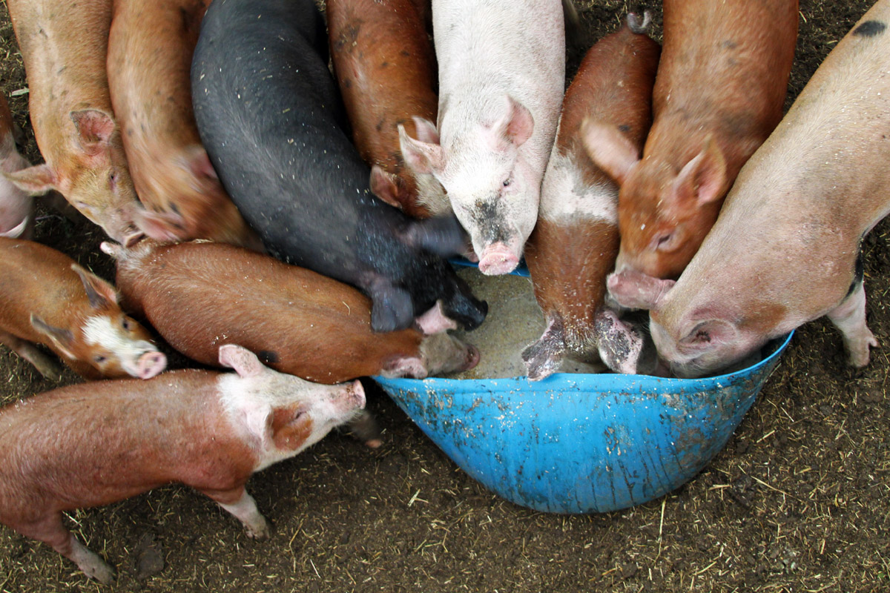
Find Your Niche and Grow!

Slide 39
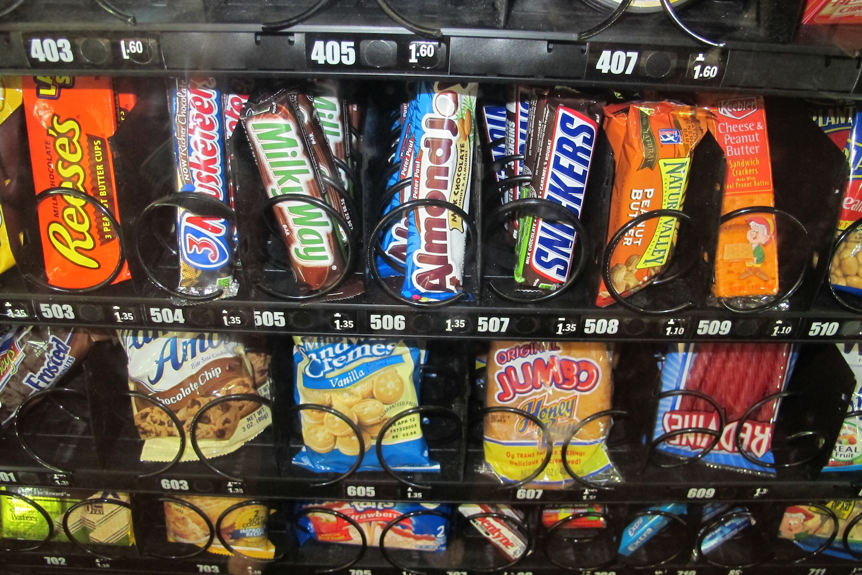
Lunch Anyone?

Slide 40
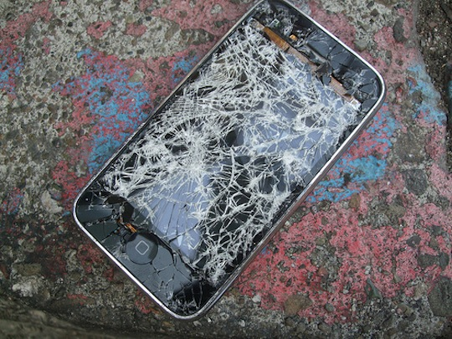
Destress / Unplug

Slide 41
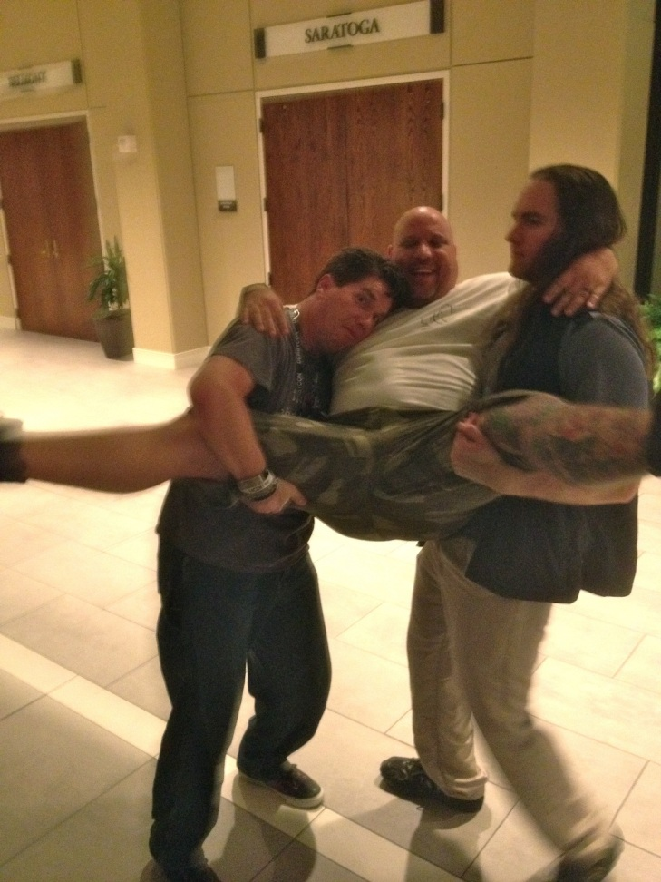
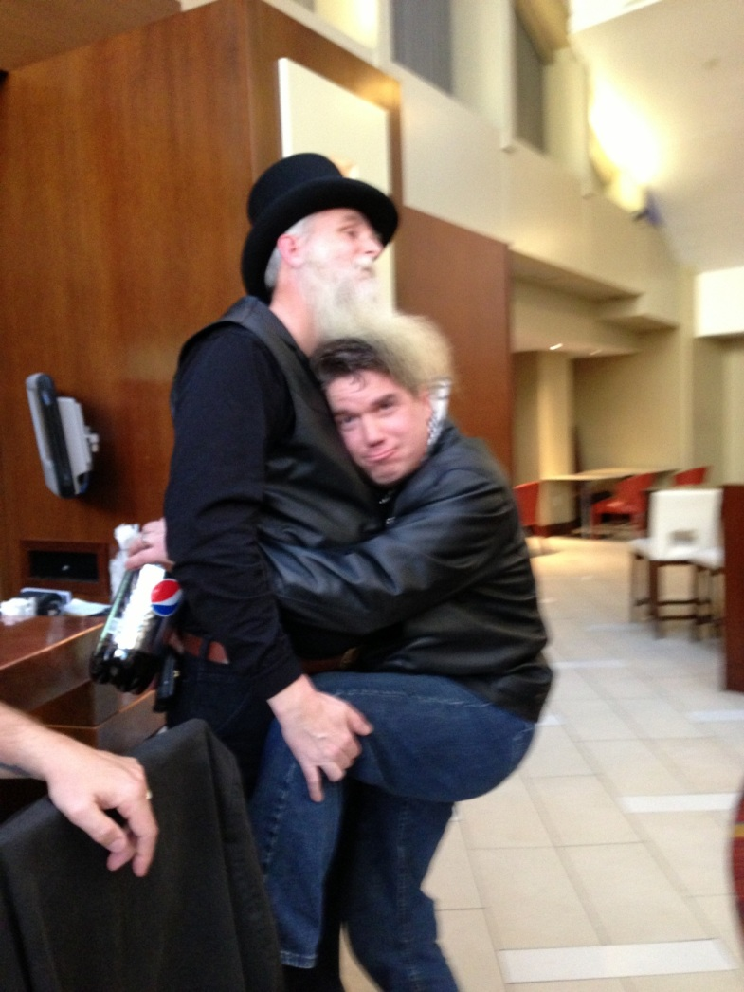
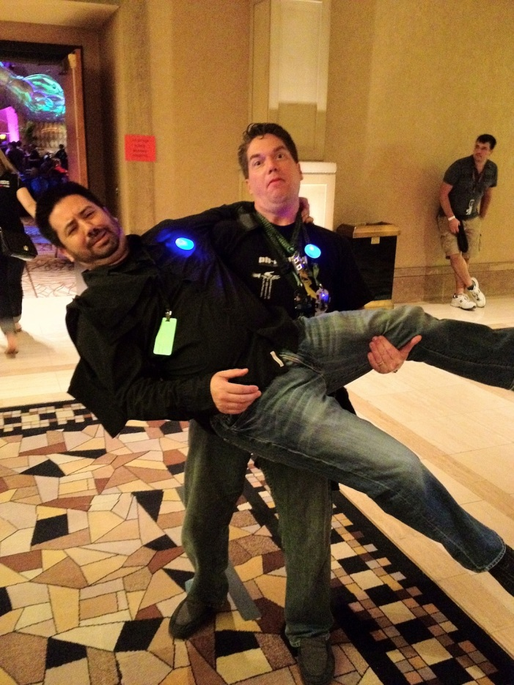
And Why Not Give Some Awkward Hugs…

Slide 42
Prevention options For Managers and Organizations

Slide 43


Slide 44
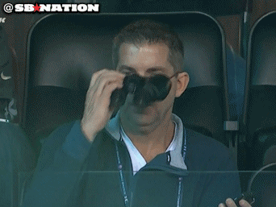
Increase Your Field of Vision

Slide 45
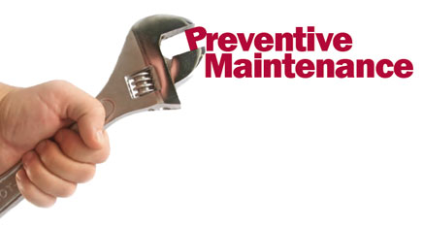
Take a Preventive Approach

Slide 46
If this hit home (even a little bit)…

Slide 47
Get In Touch With Us
Website: http://www.itburnout.org
Email: info@itburnout.org
Twitter: @itburnoutdotorg (damn Twitter Squatters!)
Facebook: /ITBurnoutPrevention

Slide 48
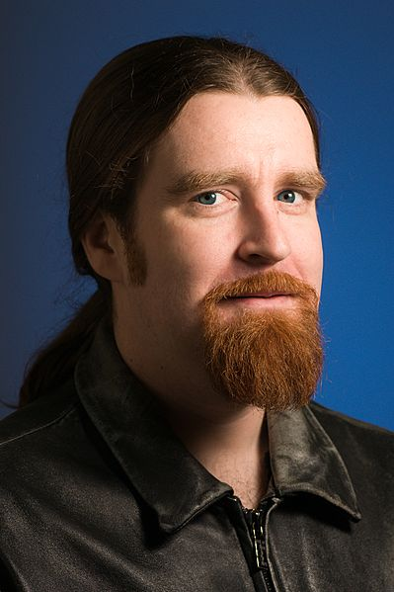
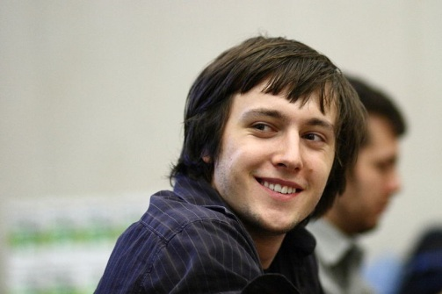

In Memoriam
Sometimes we just do not know why. We can speculate, but in the end… does it really matter ?
Len Sassaman
1980 - 2011
Ilya Zhitomirskiy
1989 - 2011
Aaron Swartz
1986 - 2013

Slide 49
Questions

